Slide 1
Spectrum Reconstruction 7/21
Reconstruction Method:
(1) Run parameter sweep (loop through all OPDs) to create characterization matrix A
Characterization matrix A is currently a square matrix (1024 x 1024)
(2) Run new experimental simulation with CW laser and optical power meter, same sweep (loop through all OPDs), but obtain all the output powers
Also obtain input spectrum with optical spectrum analyzer (OSA)
(3) Using intensities y (units: w) gathered from (2) and square characterization matrix A (units: %?) from (1), solving A⁻¹y = x to try to get input “mystery” spectrum
(4) Compare calculated “mystery” spectrum x with the OSA spectrum measurement

Slide 2
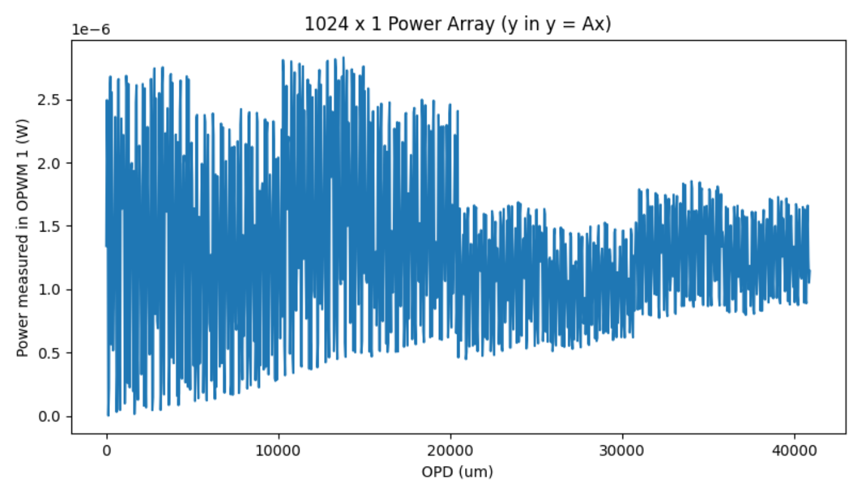
Results from spectrum reconstruction 7/21
Plot: optical power measured per path length

Slide 3
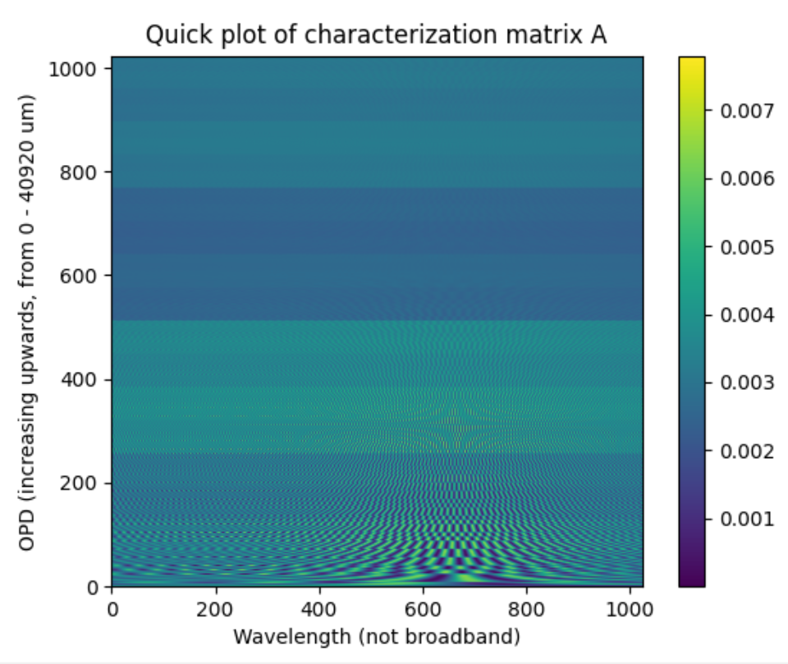
Characterization Matrix A
(not sure why there are dark bands across the matrix, FSR is still decreasing over OPD)

Slide 4
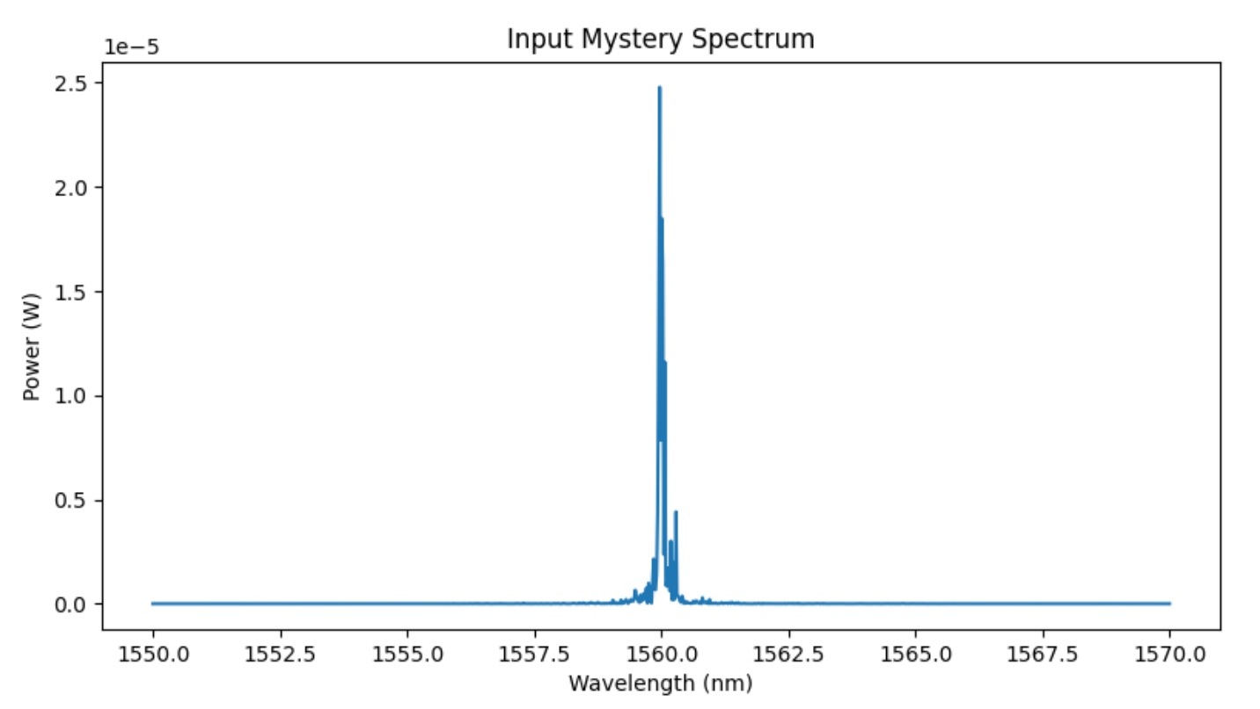
Mystery spectrum from OSA:
Power: 1 mW

Slide 5
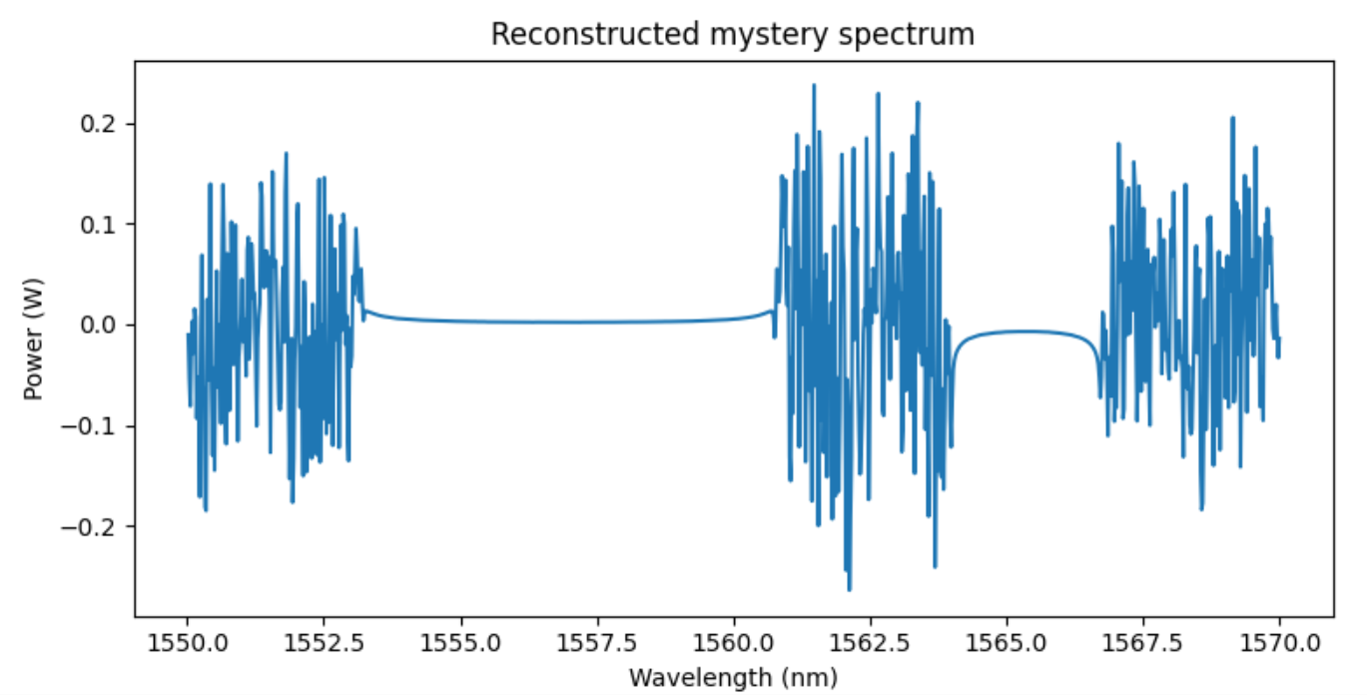
Calculating x from y and A:

Slide 6
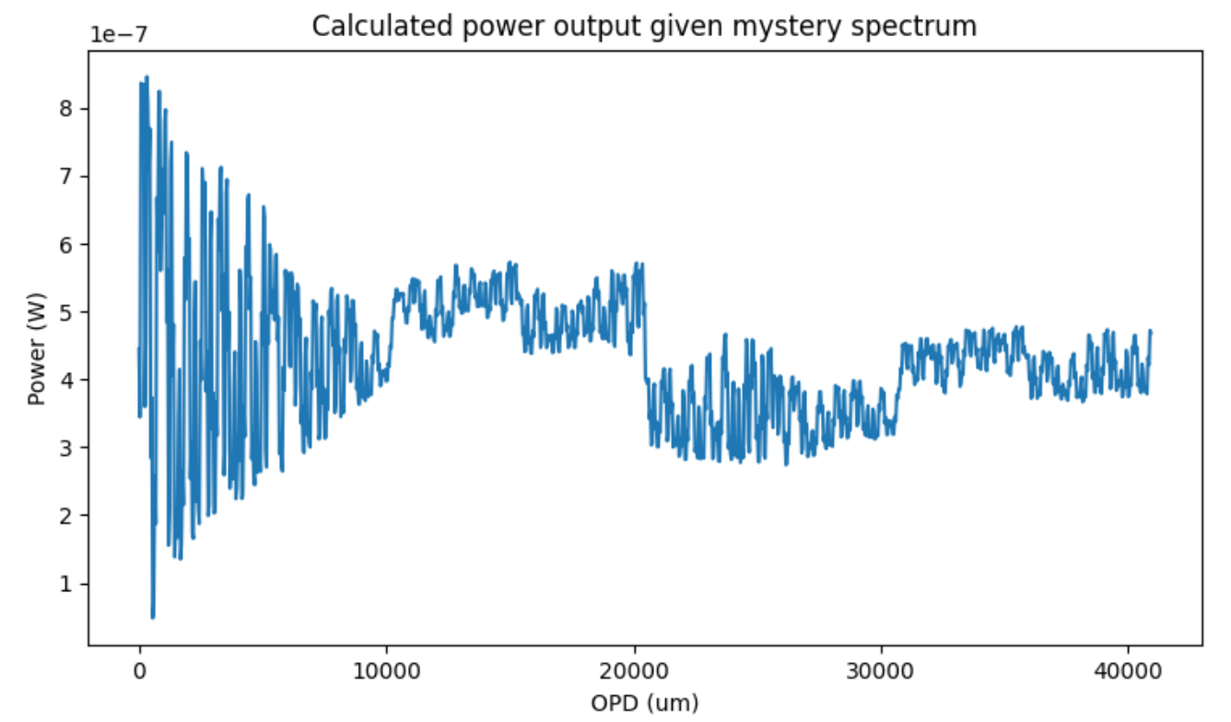
Given the input mystery spectrum & characterization matrix, what the output powers vs. OPD should look like:

Slide 7
Comparing the power outputs (expected vs. measured)
Expected Powers
Measured Powers

Slide 8
64 Paths Reconstruction (6 switches)
Details:
Longest OPD: 2520 um, n_g = 1.82, THUS: Rayleigh criterion = 0.53 nm
We need 64 sample points (we have 64 OPDs and we want square matrix)
I want a resolution 10x Rayleigh criterion (to be able to distinguish peaks even in smallest FSR value)
Thus, bandwidth is the one free variable
Solving: x/64 = 0.53/10
x = 3.392 nm
Rounding to a 3 nm bandwidth. I choose we go from 1560 – 1563 nm
THUS: when we go from 1560 – 1563 nm, we get a resolution of 0.047 nm, which is 10x as resolved as the Rayleigh criterion.

Slide 9
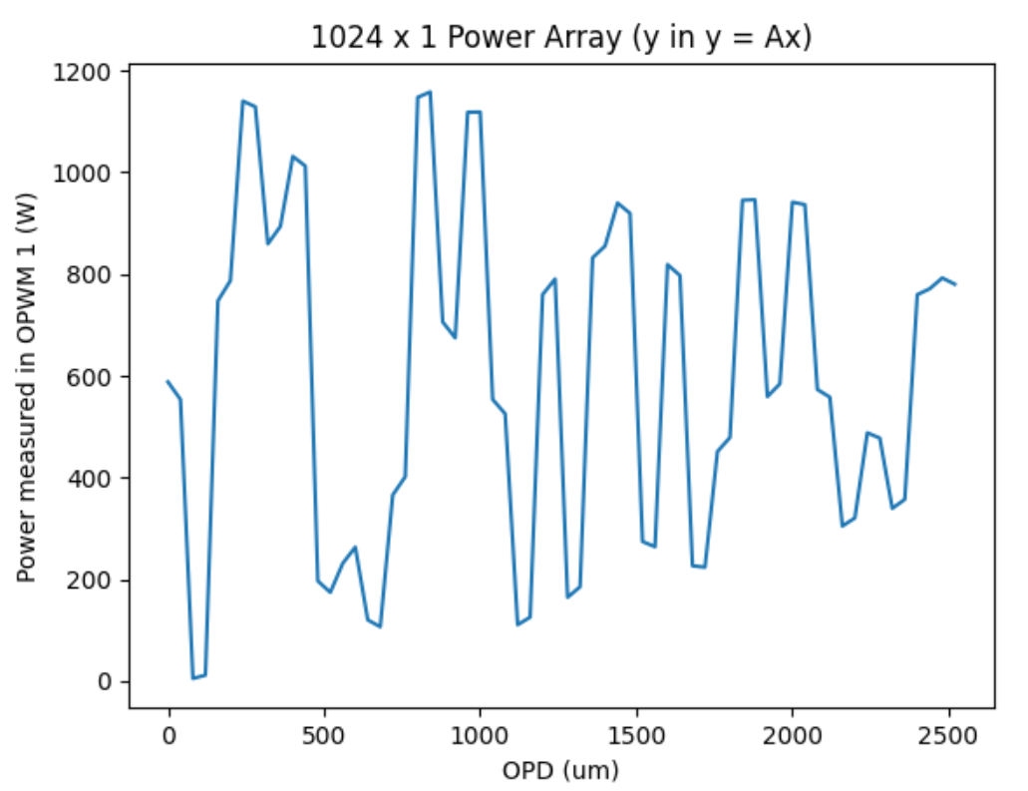
Plot: optical power measured per path length

Slide 10
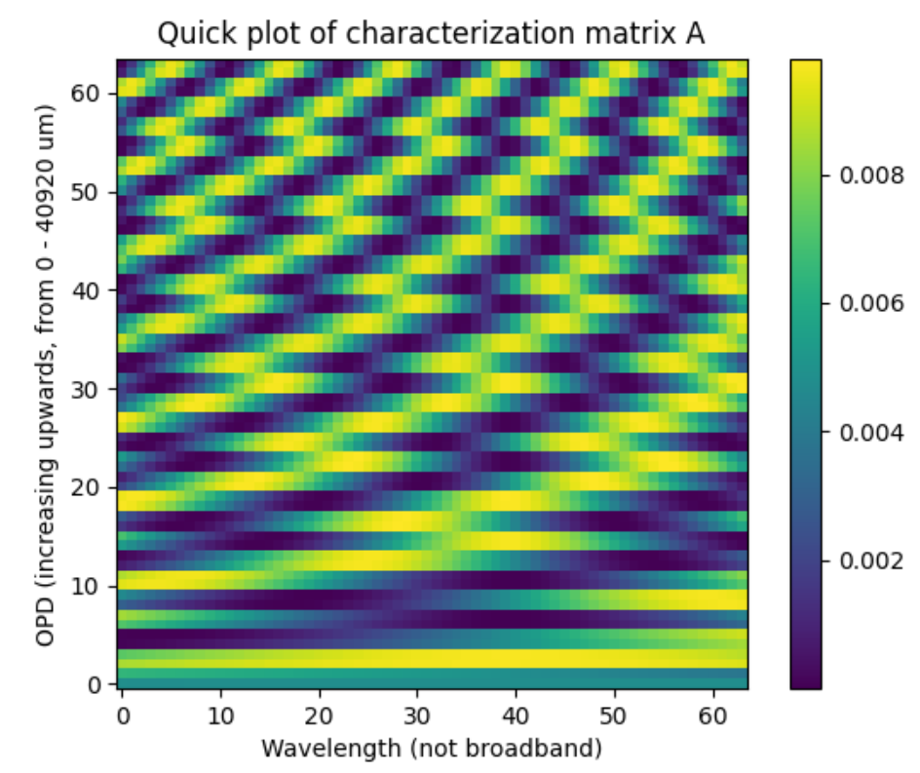
Characterization Matrix A (Abs^2)

Slide 11
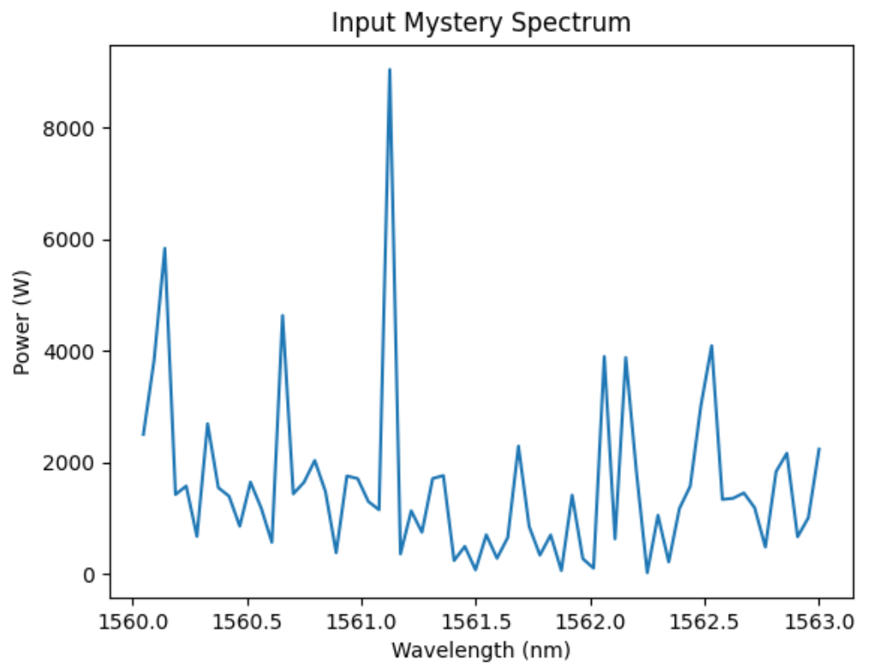
Mystery spectrum from OSA: IT MAY NOT BE WORTH IT TO LOOK AT THIS
Reason: This is sampled in the time domain, at 64 sample points, NOT in the frequency domain. Gets drastically different as number of sample points changes
Power: 1,000,000 W

Slide 12
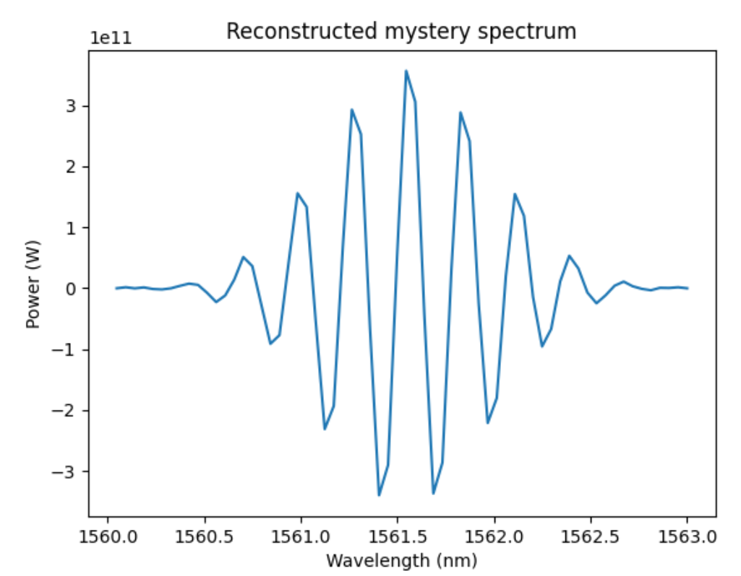
Calculating x from y and A (Abs^2): [ x = A^-1 * y ]

Slide 13
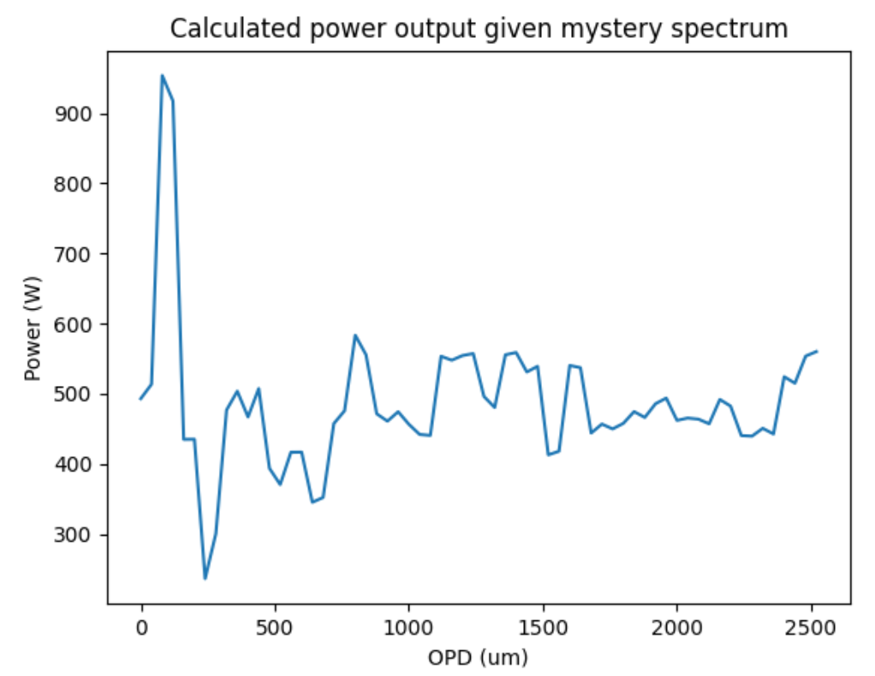
Given the input mystery spectrum & characterization matrix, what the output powers vs. OPD should look like: (AGAIN, MYSTERY SPECTRUM IS PRETTY OFF)

Slide 14
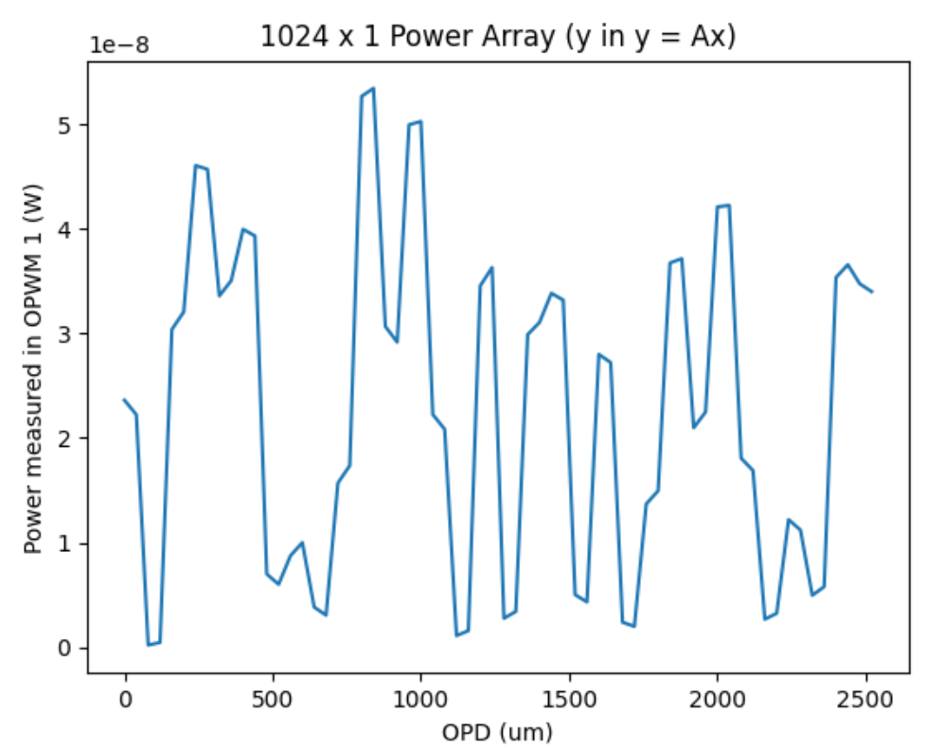
Comparing the power outputs (expected vs. measured)
Expected Powers
Measured Powers

Slide 15
DOING IT WITH 256 PATHS (8 switches)
Details:
Longest OPD: 255*40=10200um, n_g = 1.82, THUS: Rayleigh criterion = 0.131nm
We need 256 sample points (we have 256 OPDs and we want square matrix)
I want a resolution 10x Rayleigh criterion (to be able to distinguish peaks even in smallest FSR value)
Thus, bandwidth is the one free variable
Solving: x/256 = 0.131/10
x = 3.356 nm
Rounding to a 3 nm bandwidth. I choose we go from 1560 – 1563 nm
THUS: when we go from 1560 – 1563 nm, we get a resolution of 0.0117 nm, which is 10x as resolved as the Rayleigh criterion.

Slide 16
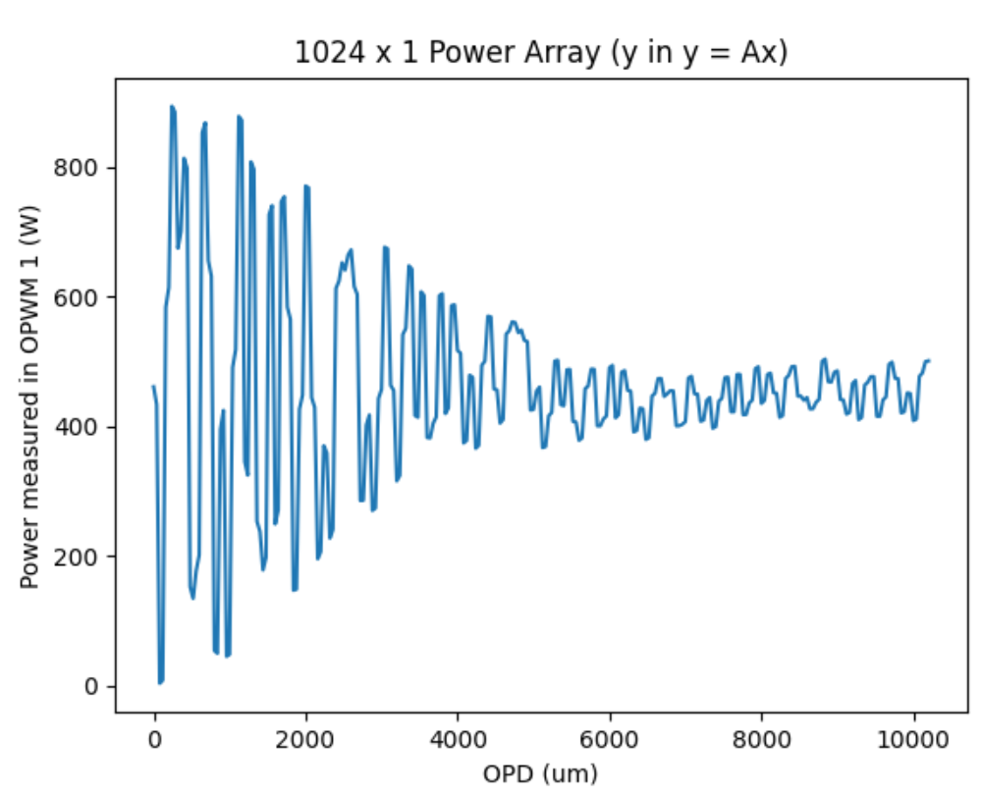
Plot: optical power measured per path length

Slide 17
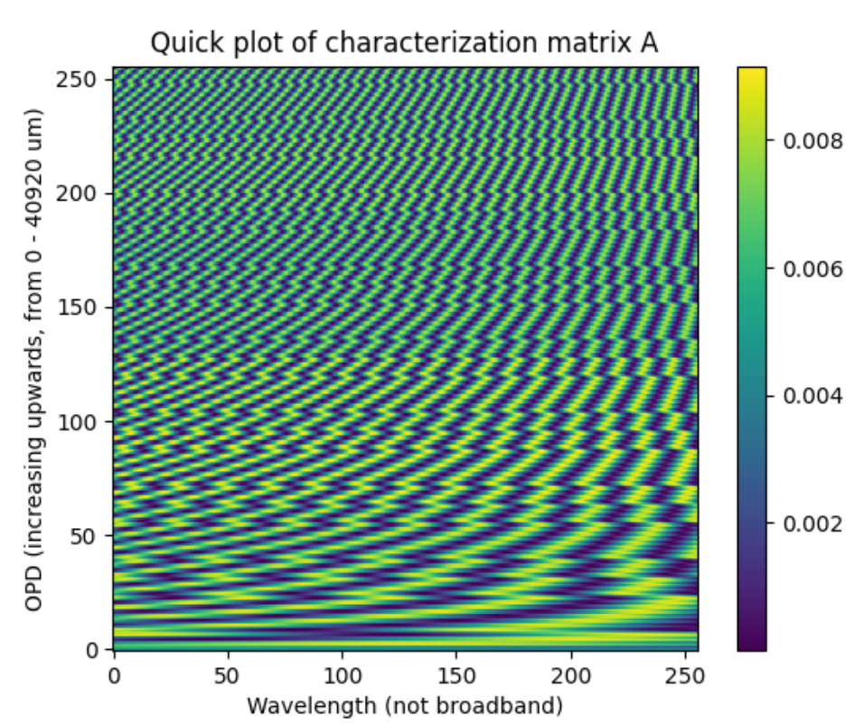
Characterization Matrix A (Abs^2)

Slide 18
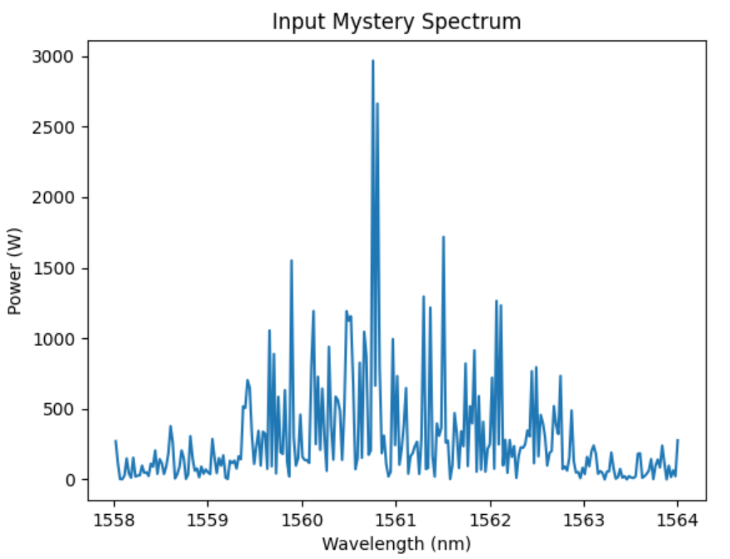
Mystery spectrum from OSA: IT MAY NOT BE WORTH IT TO LOOK AT THIS
Reason: same as above. Basically, OSA is not accurate and shouldn’t be used (instead, we should infer the plot based on the parameters of 1 nm line width at 1561)
Power: 1,000,000 W

Slide 19
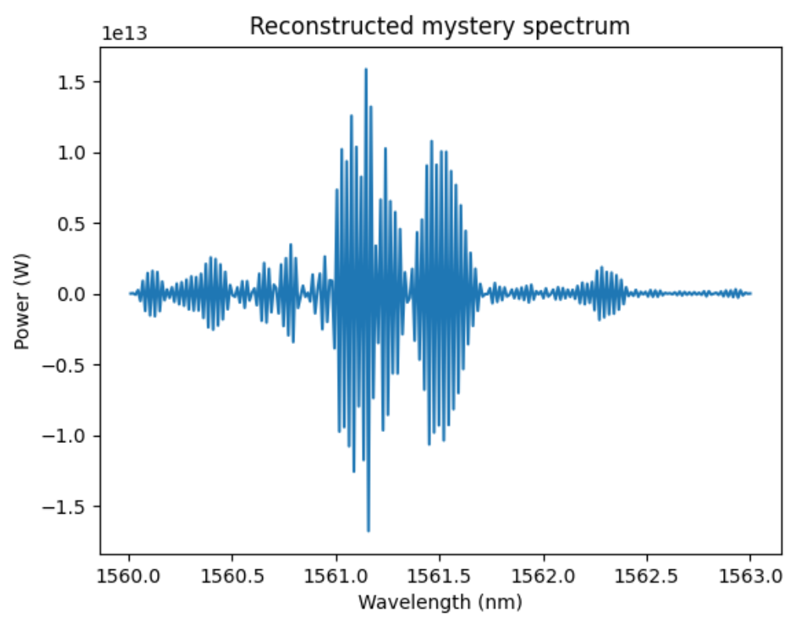
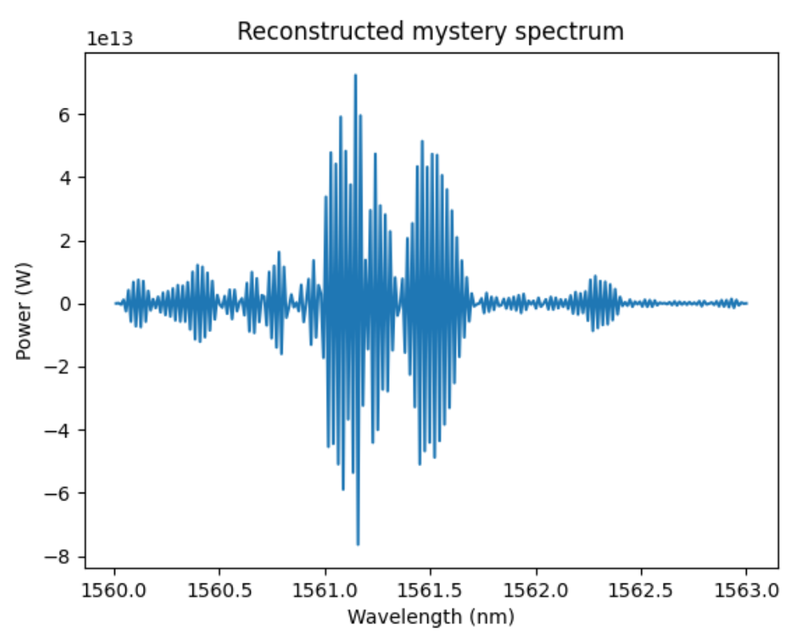
Calculating x from y and A (Abs^2): same [ x = A^-1 * y ]
Same number of samples as in 6-switch simulation (1024 samples), what happens when we have more samples (2048)??
Stays basically the same:

Slide 20
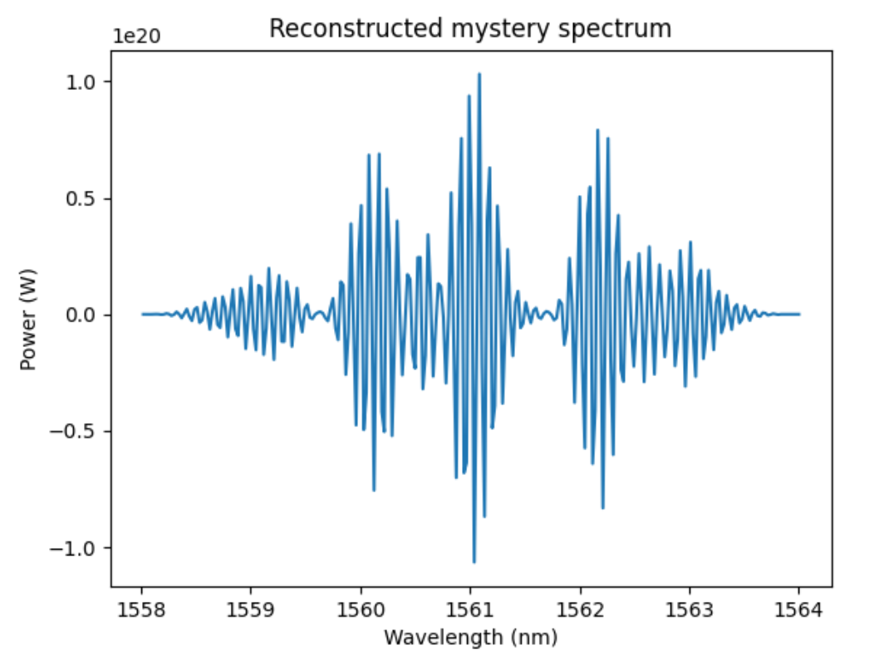
Calculating x from y and A using conjugates?? Something weird
Normally, A is in Abs^2
But if we separate the Re(A) + Im(A) and Re(A) – Im(A), we get:
y = (Re(A)+Im(A))*x*(Re(A)-Im(A)) and then,
x = (Re(A)+Im(A))⁻¹*y*(Re(A)-Im(A))⁻¹
Plot becomes a lot smoother, but weird??
Originally did this because I was trying to fix the negative power problem (that maybe the “direction” of the complex number mattered, but hidden by the Abs operation)

Slide 21
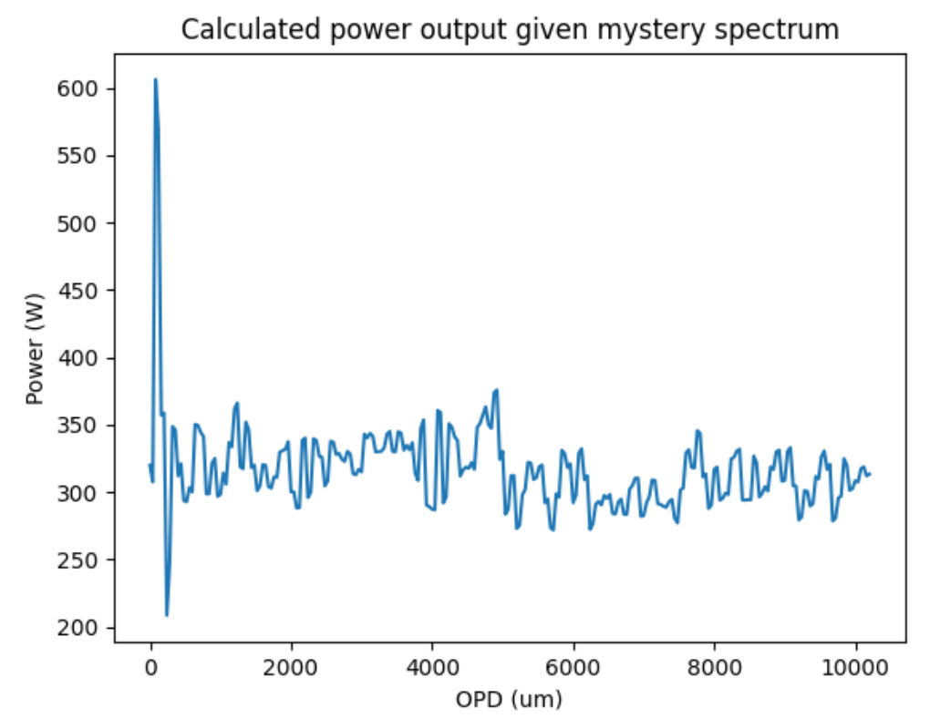
Given the input mystery spectrum & characterization matrix, what the output powers vs. OPD should look like: (AGAIN, MYSTERY SPECTRUM IS OFF, this plot should not be considered)

Slide 22
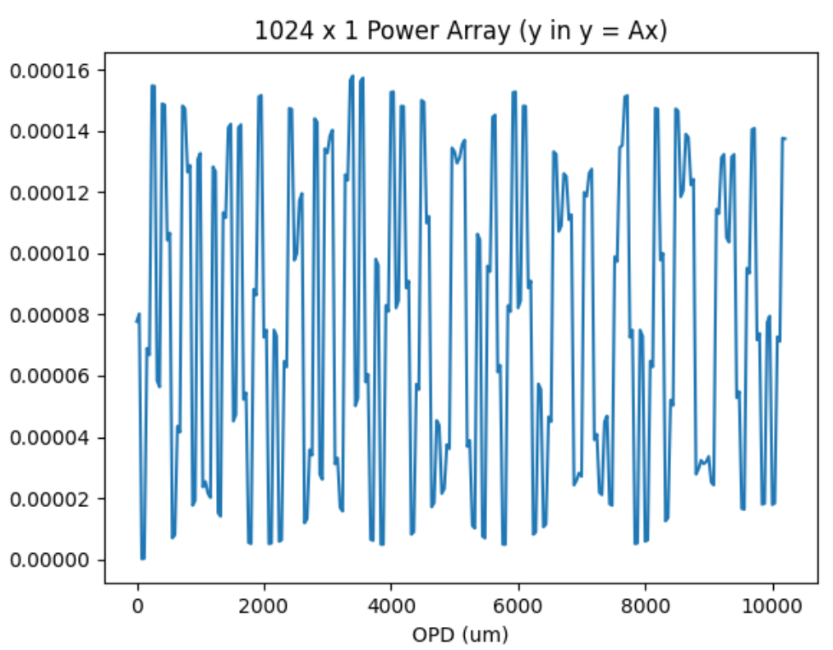
Comparing the power outputs (expected vs. measured)
Expected Powers
Measured Powers

Slide 23
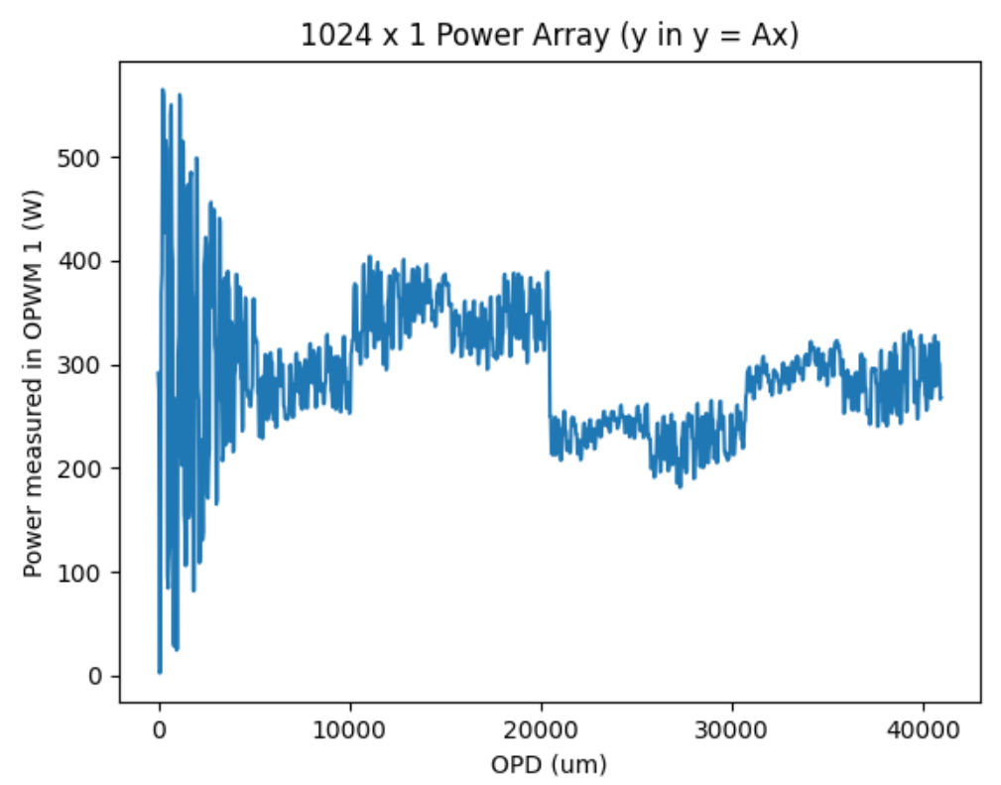
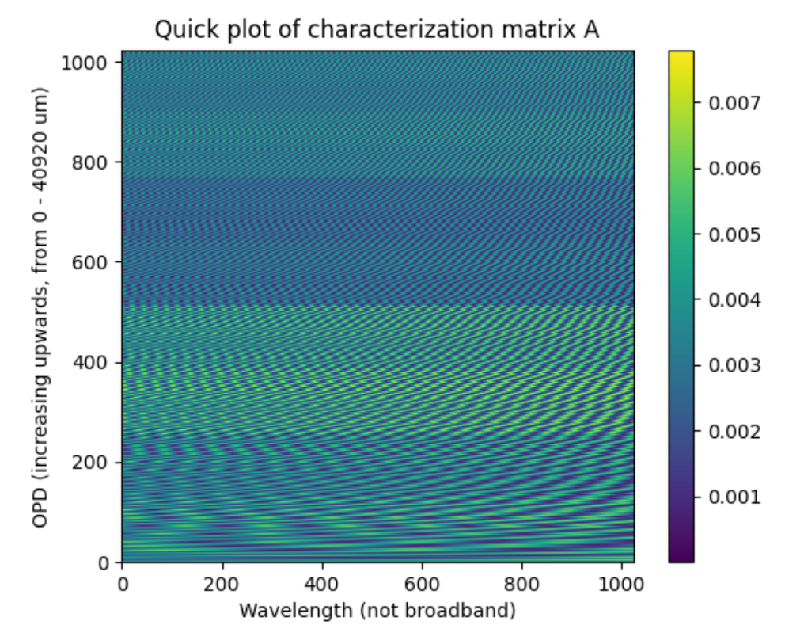
10 switches
3 nm bandwidth again (10x the sampling of Rayleigh criterion)
Rayleigh resolution: 0.0327 nm, we sample at 0.00293 nm
Measured power per OPD
Characterization Matrix A (Abs^2)

Slide 24
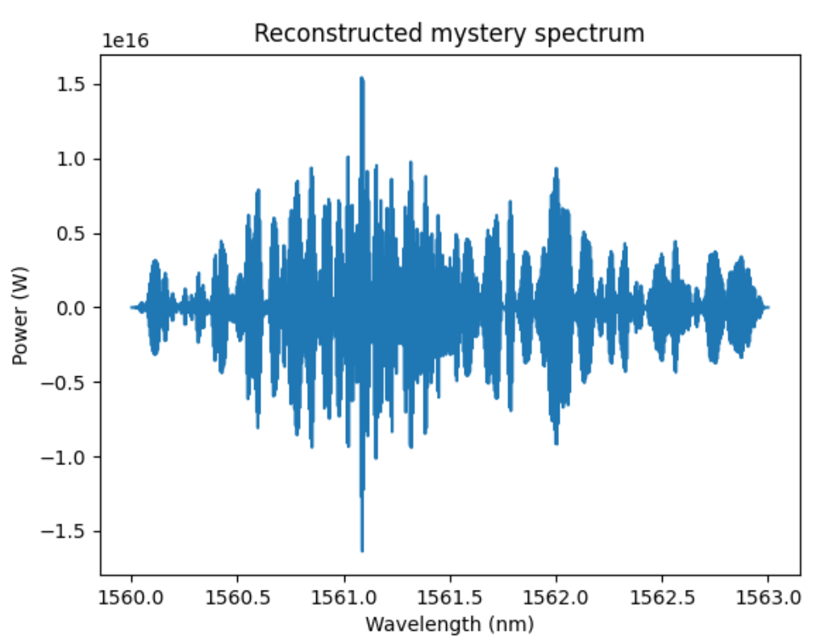
Reconstructed via [ x = A^-1 * y ], where A is Abs^2

Slide 25
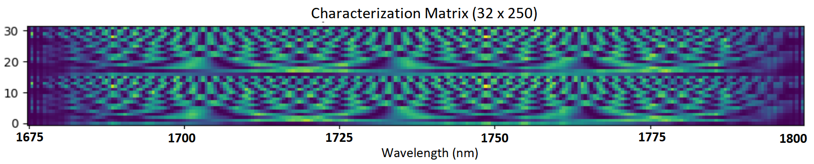
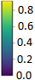
Equinor simulation framework created w/ adiabatic couplers
Bandwidth: 1675 – 1800 nm, adiabatic couplers w/ different switch logic
Equinor adiabatic simulation file created and simulations run:
Created characterization matrix, look at transmissions through GUI. Stacking the characterization matrices
Look at Equinor-s-matrix/run_sweep_analysis_2.py
Everything seems to look good for adiabatic couplers?
Incorporation of ML reconstruction for non-square matrix
Phase shifters centered at 1706 nm
Phase shifters centered at 1769 nm

Slide 26
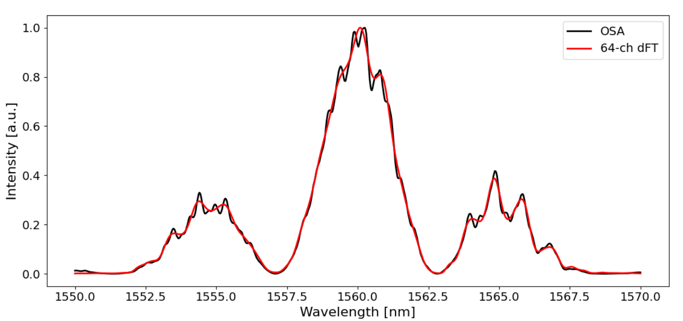
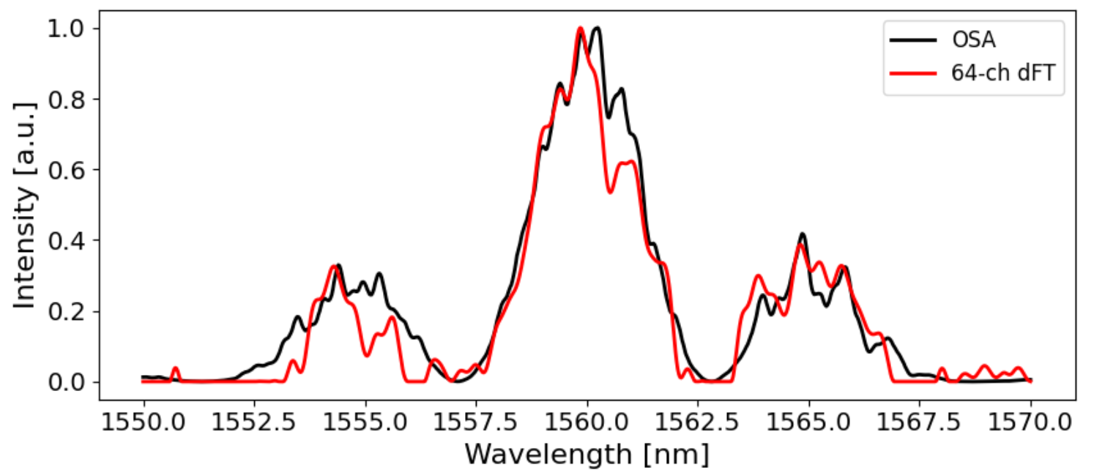
Elastic D1 reconstruction in simulation
With output from the interconnect simulation ran the elastic D1 reconstruction
HOWEVER, IN SIMULATION, NO NOISE:
x input array is the MZI1 data from 2018 (801 pts)
A is our simulation’s characterization matrix (64 x 801 pts)
y is the exact intensities with no noise (64 pts), calculated from y = Ax
Given y and A, solving for x (which is an under-constrained problem)
Reconstruction of x (with no noise):
(for reference) reconstruction with experiment data
Condition number of A used in 2018 experiments: 115.5 (note: A is non-square here)

Slide 27
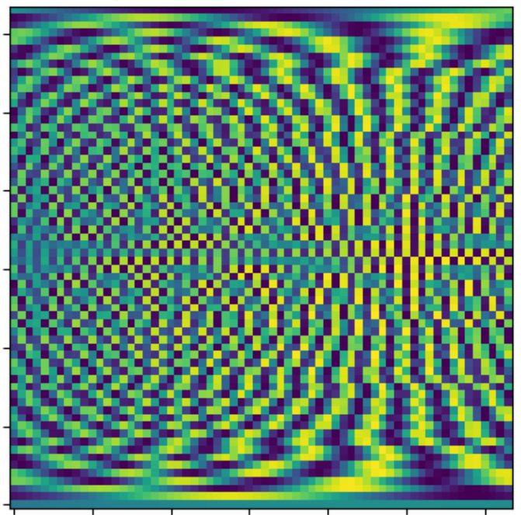
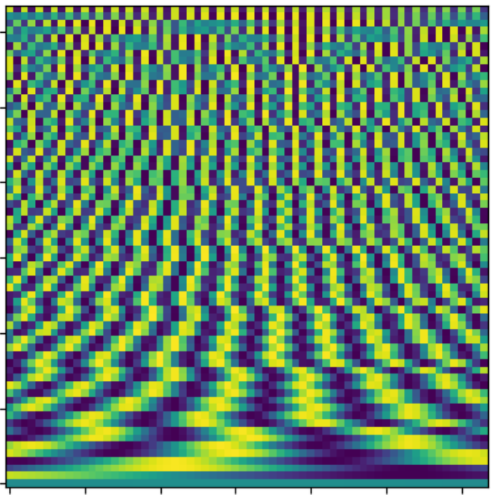
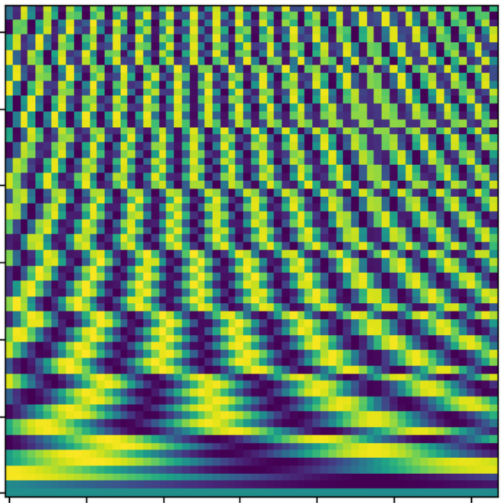
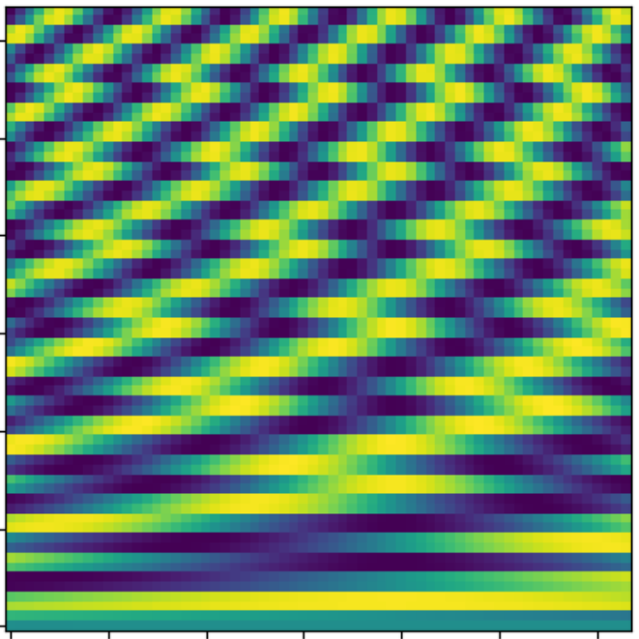
Looking at condition number (here, 64 points)
Given the Rayleigh criterion, what is the relationship between resolution and condition number of the characterization matrix, i.e., how should we sample each transmission? Looking at square characterization matrix first (findings will translate to under-constrained problems?):
For resolution = Rayleigh/1: condition number = 434.6
I shifted the window by 1 nm, condition number became 326.7
For resolution = Rayleigh/2: condition number = 86.5
For resolution ~ Rayleigh/3: condition number = 3628476.1
For resolution ~ Rayleigh/10: condition number = 2330399912.7
Guesses:
Resolution = 2*Rayleigh is the best? ← thought: here, we sample smallest FSR at its peaks
We need to sample the transmission of the greatest OPD at its maxes and mins?
Could potentially derive it out; create a function to relate resolution & condition number to find the true minimum.

Slide 28
Some questions about condition #
Looking at under-constrained systems: is it better to add another row of the characterization matrix or lower the condition number and don’t add it at all?
What would be the algorithm to gauge whether adding another transmission is better or not?
E.g. have everything under-constrained, measure condition number, and then add it (a bit more constrained), and measure condition number again..?
Or, can only same-dimensioned matrices be compared?
Condition number of non-square matrices: can we compare condition numbers of differently dimensioned matrices? Of even similarly-dimensioned matrices?

Slide 29
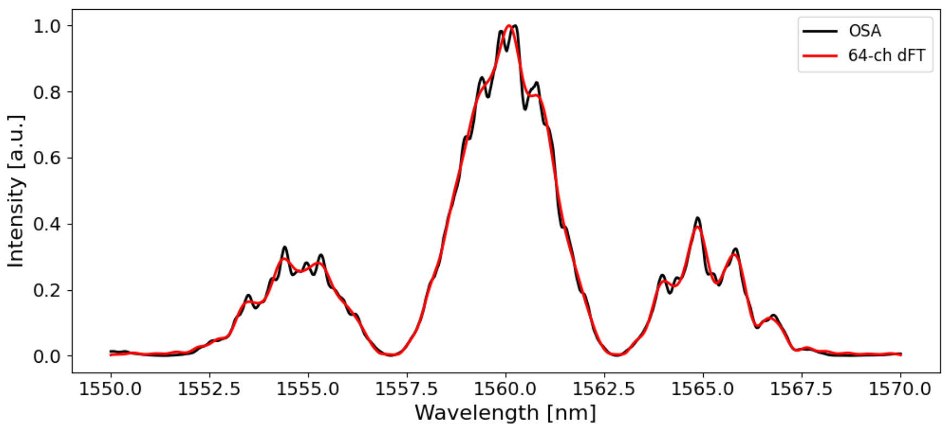
Question: add a pi/2 phase shifter on one arm?
Adding a phase shifter shifts the transmission but keeps the FSR (while thinking about accumulated phase shifts)
cos(2pi/x) & cos(2pi/x+pi/2) are linearly independent—doubles the number of sample points, with only one phase shifter rather than an entire switch
https://www.desmos.com/calculator/qptkrndpbg
Also, it (somewhat) mirrors the Hadamard matrix – the horizontal shift in a row. Should have better condition number.
Testing it with Elastic D1 reconstruction:
Similar R² value, but the condition number of the old characterization matrix is quite a bit larger than the new characterization matrix. Thus, it means less effect of noise on the new characterization matrix?
Old, 6 switch reconstruction
5 switch reconstruction + Pi/2 phase shifter
R² = 0.9961
R² = 0.9962
Condition number of A = 79.98
Condition number of A = 21.41

Slide 30
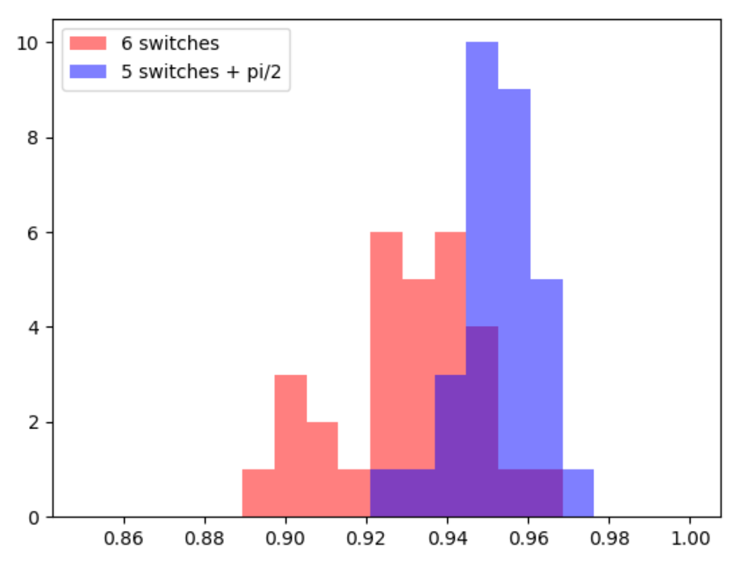
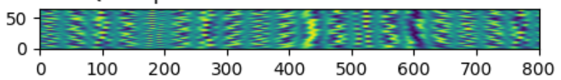
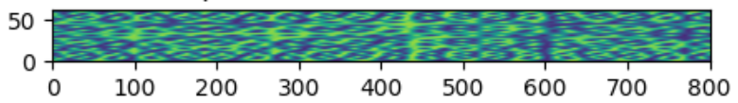
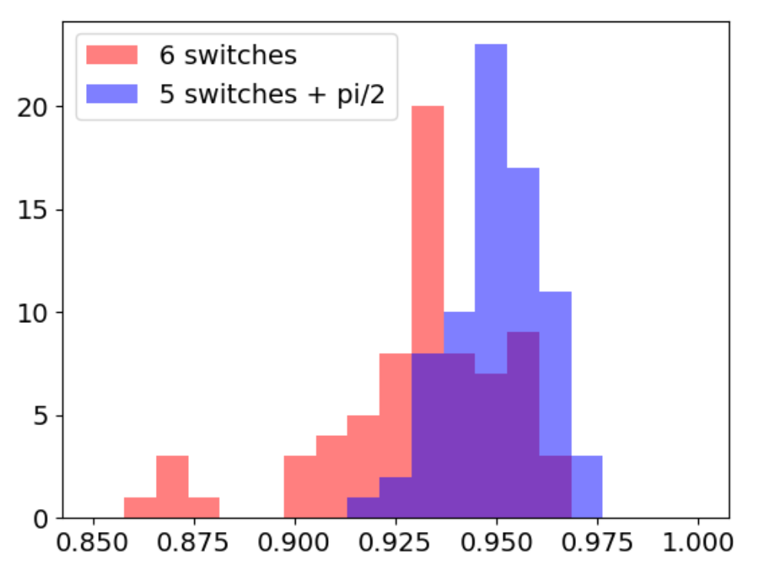
Looking at condition # and noise amplification
Looking at the old 6 switch DFT vs. the 5 switch DFT + pi/2 shift (both 64x801) with added noise:
Characterization matrix from old 6-switch DFT
condition #: 79.98
Repeat 30 times each, 30 R² values, histogram
Added 3% random gaussian noise to y
Elastic D1 to reconstruct x, then calculate R²
Calculate y by Ax
Characterization matrix from 5 switch DFT + pi/2 shift
condition #: 21.41
Added 3% random gaussian noise to y
Elastic D1 to reconstruct x, then calculate R²
Calculate y by Ax
An improvement in condition number did seem to increase reconstruction accuracy with noise
stored/R2_6switches_5switchespi2.pickle

Slide 31
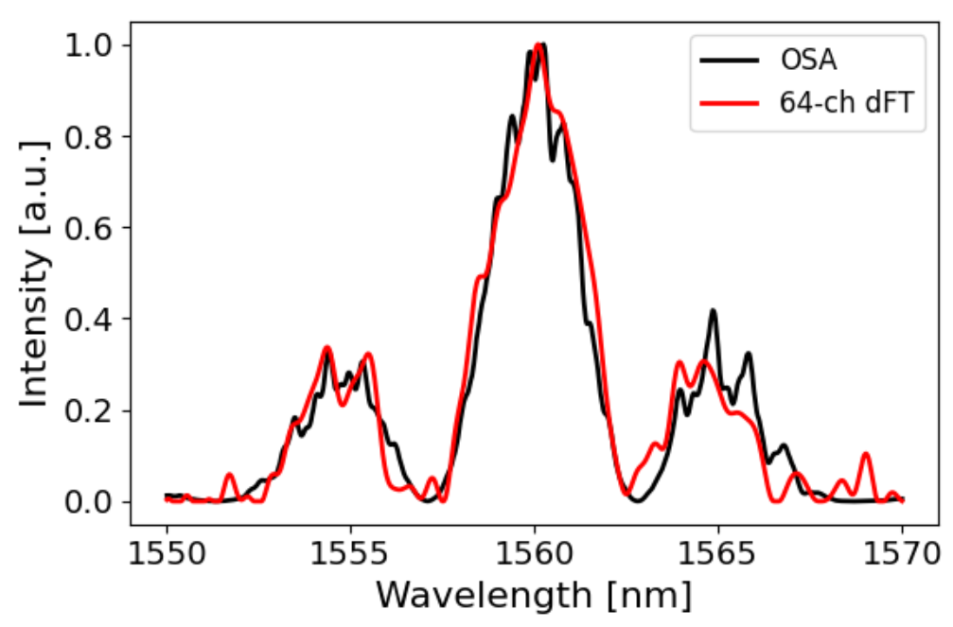
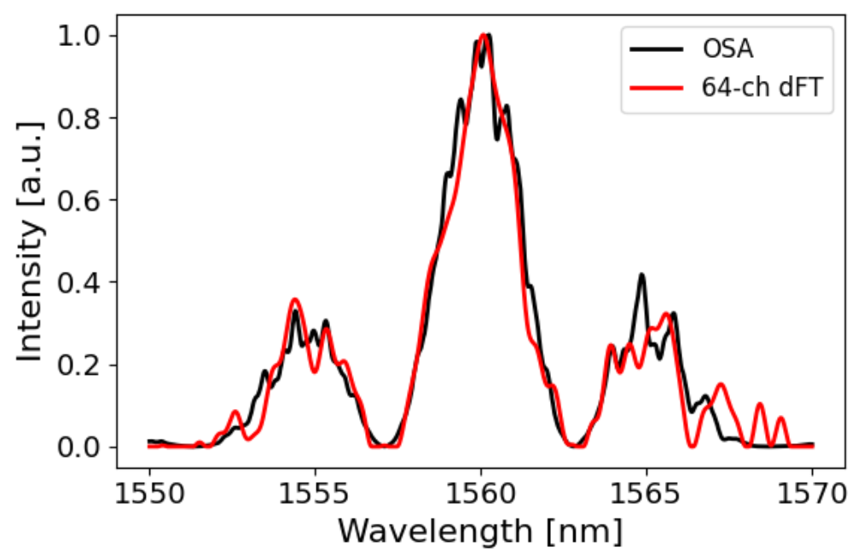

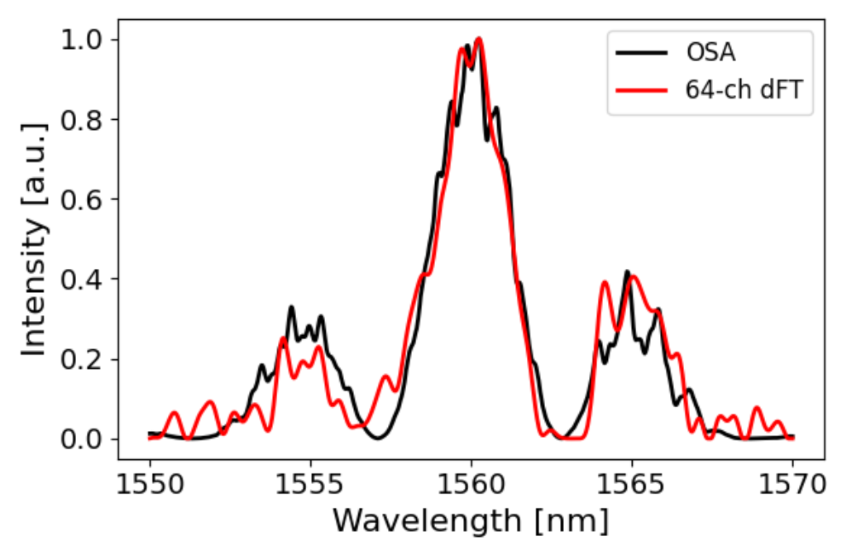
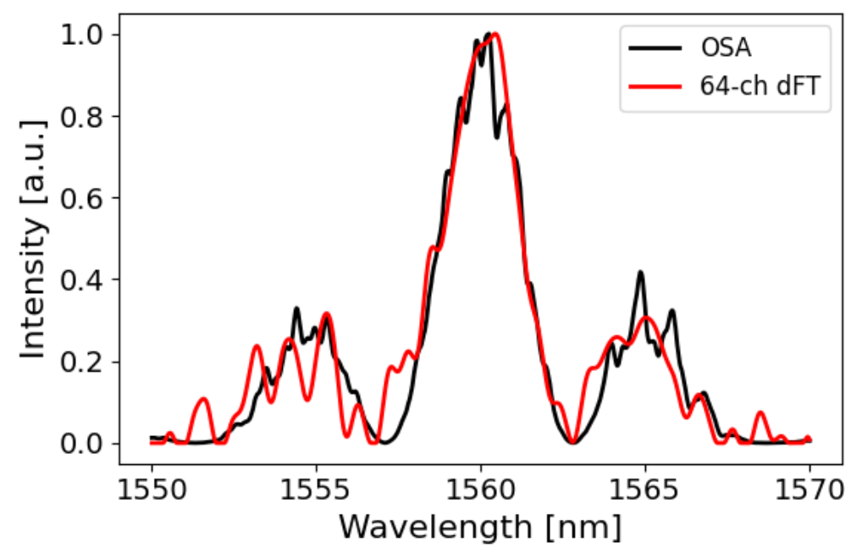
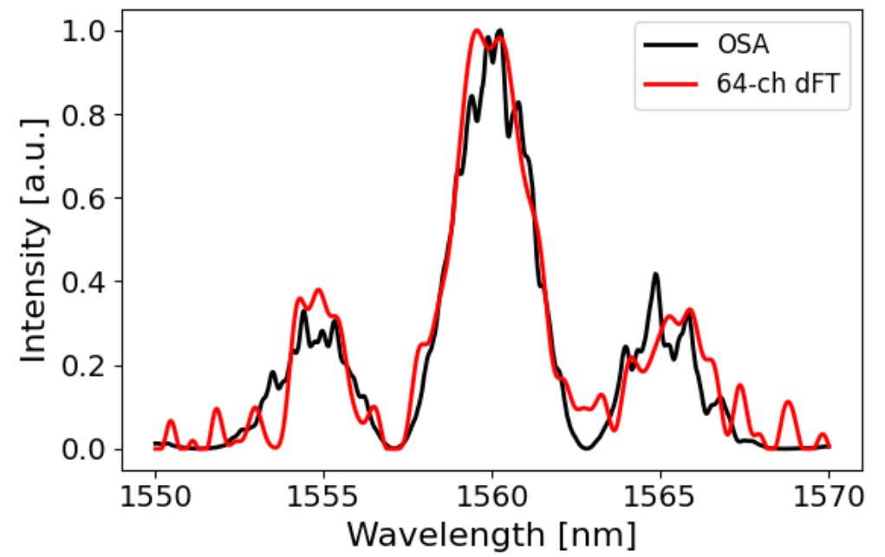
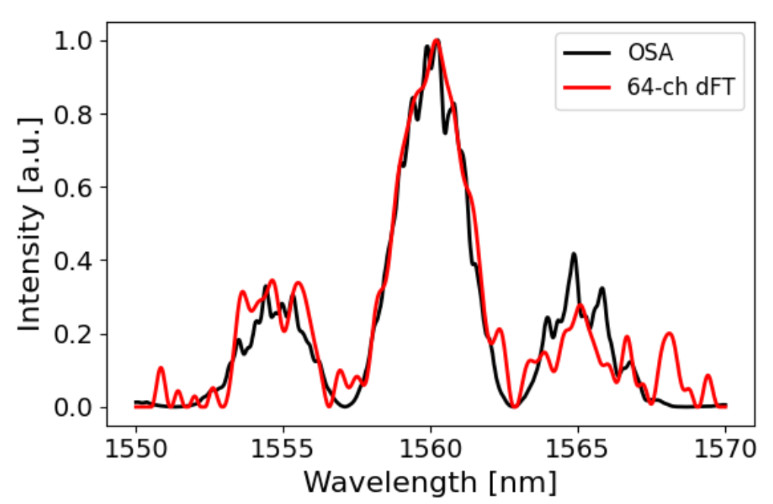
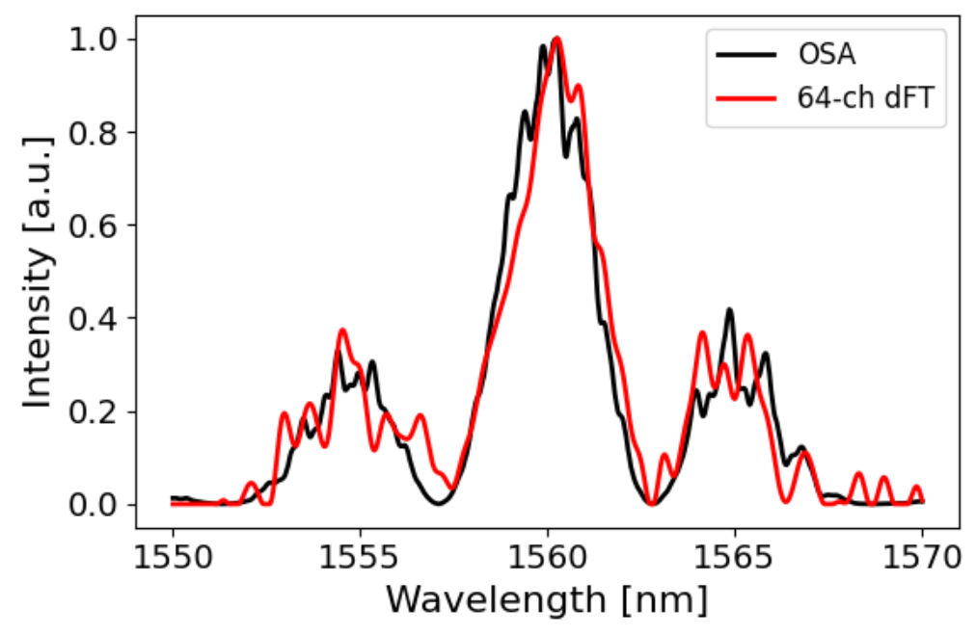
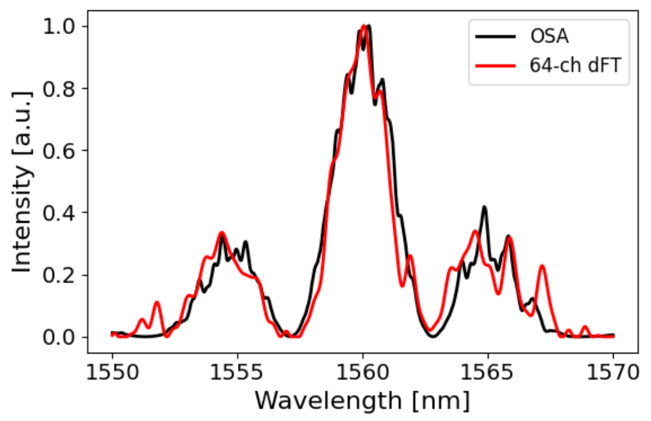
R2 = 0.948
R2 = 0.953
R2 = 0.952
R2 = 0.925
R2 = 0.926
R2 = 0.922
R2 = 0.919
R2 = 0.920
R2 = 0.933

Slide 32
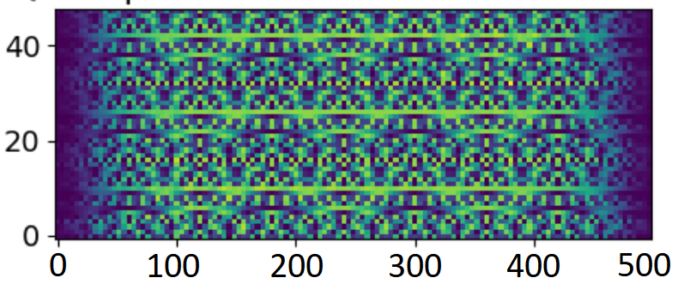
Broadband reconstruction w/ elastic d1
For full 10-switch reconstruction (1200-1700 nm w/ 0.02 nm resolution) and 5 windows, the simulation takes estimated 7 days and 10 hours.
First trying 4 switches (1500-1600 nm w/ 0.2 nm resolution) and 3 windows
Characterization matrix is (16 OPLs * 3 voltage settings) x (4000 points / 8) = 48 x 500
Huge amplification of noise when we stack matrices of each “window”?
Condition number of A: 19,100,907
The three 16x500 matrices (one for each voltage setting) were stacked vertically
Condition number of first 16 rows of A: 17.5
Condition number of second 16 rows of A: 19.7
Condition number of third 16 rows of A: 19.1
Condition number of first 8 rows + third 8 rows of A: 406
Condition number of first 8 rows + fifth 8 rows of A: 4510
The three 16x500 matrices are pretty similar

Slide 33
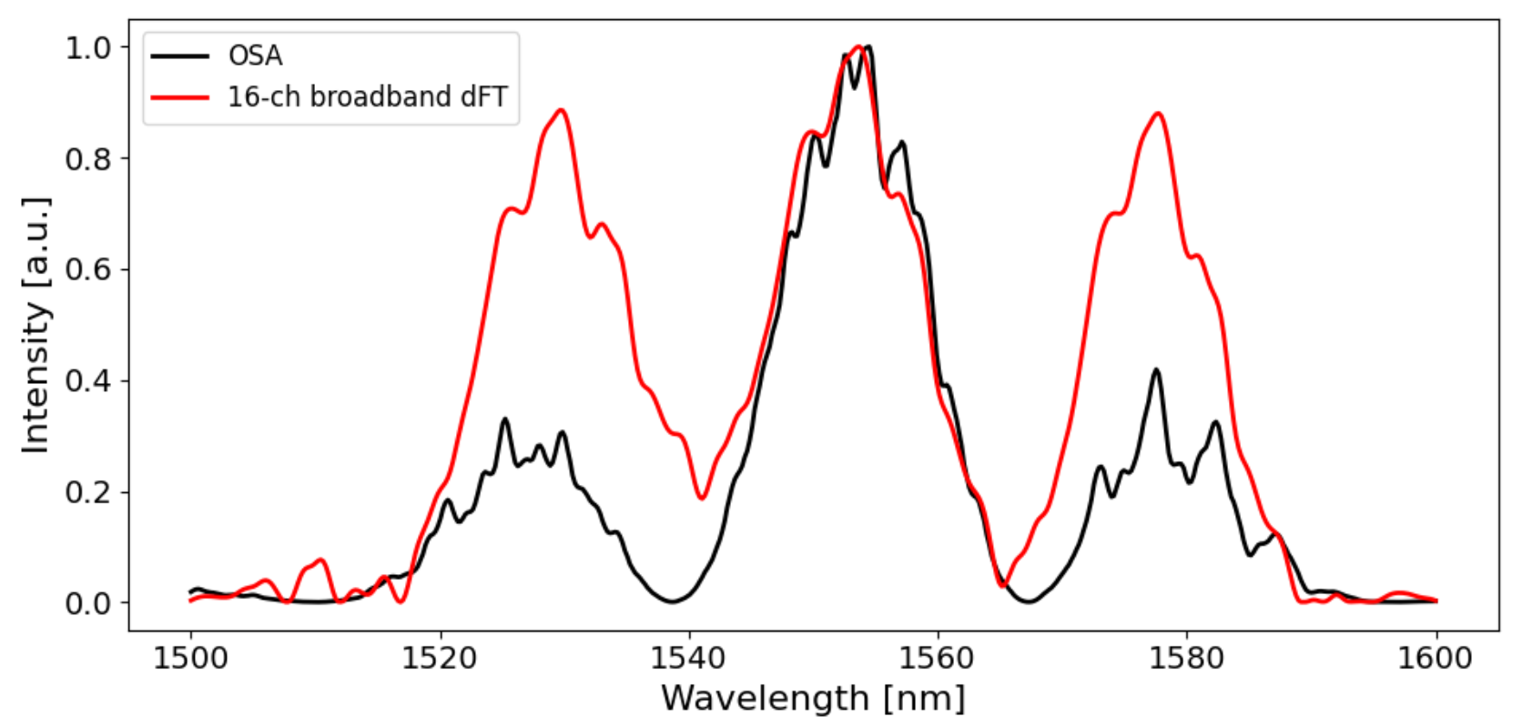
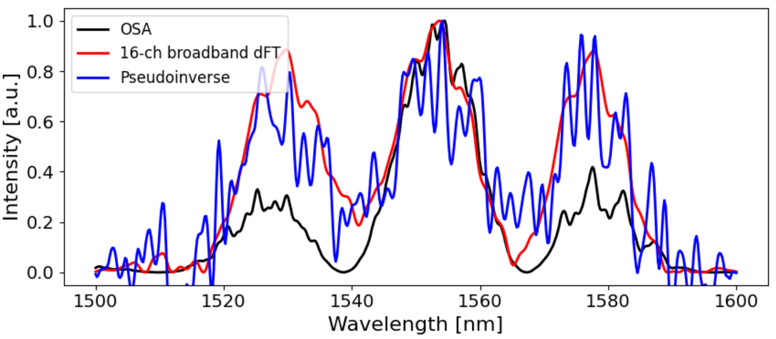
Current reconstruction with 48 x 500 A-matrix (no noise)
Pretty odd—no noise, should be a pretty accurate reconstruction
Pseudoinverse reconstruction also seems to follow elastic d1 reconstruction
Same result when parameter space is 12x12x12
Running again on 64 x 801 (whether it’s due to level of underconstrained-ness)
Still doesn’t work: the transmissions aren’t different enough? Probably
For a square matrix, it should always perfectly reconstruct AS LONG AS LINEARLY INDEPENDENT(?). This isn’t a square matrix, so reconstruction is dependent on the info given to the algorithm(?). Can we simplify the unconstrained matrices to show how much actual useful information we have (e.g. go down to 35 x 801 or something)?
About 5 switches + pi/2 (smallest only) giving huge cond # but great reconstruction: could potentially look into how cond # is derived, figure out a new cond # that tells us how “good” an under-constrained matrix is.

Slide 34
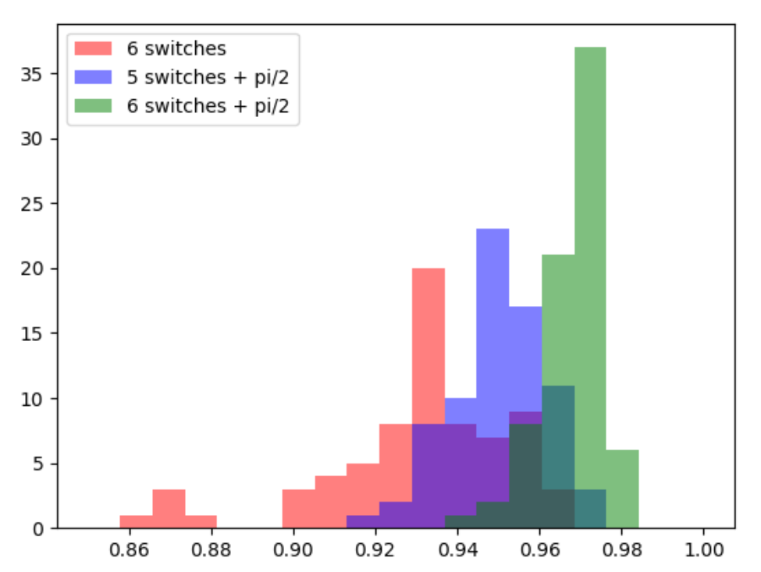
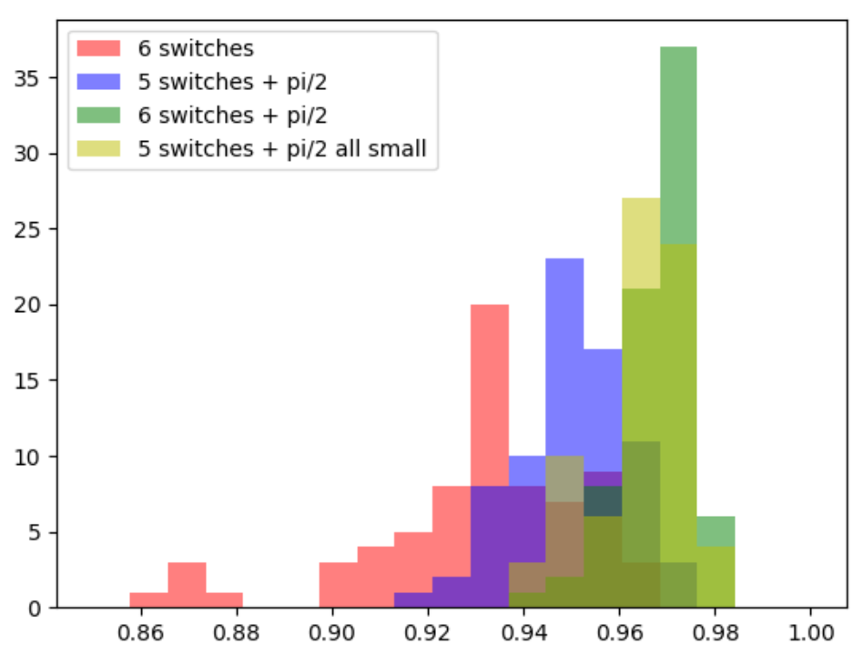
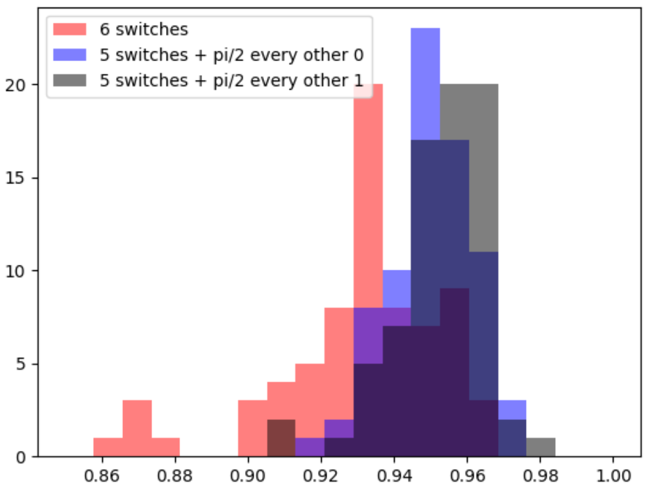
Looking at reconstruction accuracy for different configs. Steps:
Ran simulations with the following conditions (see legends) to get A matrix
Number of switches/which switches, whether adding a pi/2 phase shifter on one arm
Repeatedly reconstructed MZI1 with 3% noise to get R^2 values (75 each)
Condition #’s of A matrix:
6 switches no pi/2: 79.98
5 switches + pi/2: 21.41
6 switches + pi/2: 72457
5 switches + pi/2 all small: 56115
5 switches + pi/2 every other, larger: 23310
Basically: Cond # isn’t accurate, just use R^2 as the sole metric for now.
Could potentially derive a new type of condition # assoc. with Elastic-D1 in the future for faster evaluation.
Count
R² Value
sin(L/λ)
cos(L/λ)
L axis
(discrete)
|||||||||||||||||||||||||||||||||||||||||||||||||||||||||||

Slide 35
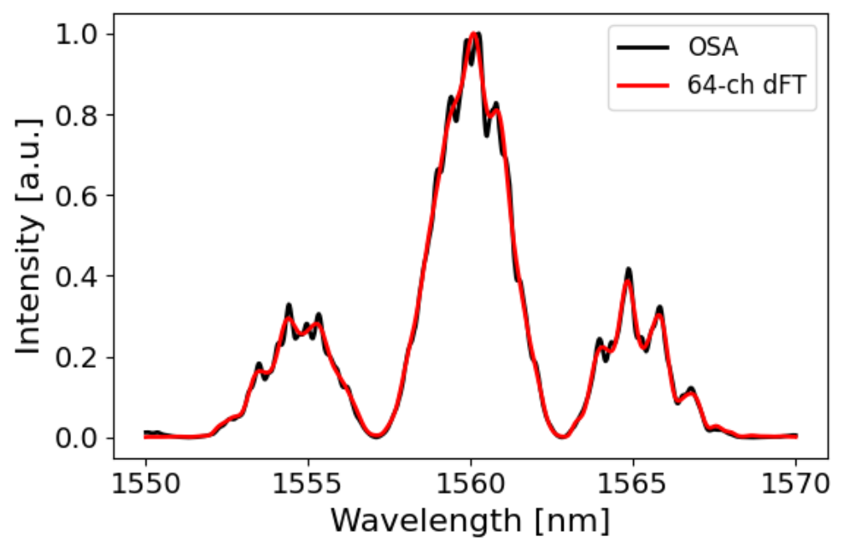














What is happening
It could be because some are just tuned better to elastic d1 parameter space? Run at higher 6x6x6. Not the reason.
6 switch old
5switchpi2 every other 0
5switchpi2 every other 1
5switchpi2 all small
5switchpi2 all big
5switchpi2 all small dL 400
6switchpi2
cond #
80.0
allshifted: 47.2
21.4
23310
56115.1
51567.6
33475.9
72457.4 (but, 128x801)
no noise
R2 = 0.9961
R2 = 0.9962
R2 = 0.9961
R2 = 0.988
R2 = -0.569 (at 6^3, R2=-0.978)
(at 8^3, R2=-1.15)
R2 = =-0.810
(at 6^3, -1.234)
(at 8^3, -0.647)
R2 = 0.9963
3% noise
(w/ just one example)
R2 = 0.922
allshifted: 0.945
R2 = 0.952
R2 = 0.937
R2 = 0.96 something
R2 = -1.423
R2 = -3.659
R2 = 0.974
A2
same for A2
same for A2
same for A2
same for A2
same for A2, R2 = -3.232
same for A2
R2 = -3.15

Slide 36


Making guesses/misc. thoughts
My guess: Just make OPDs as small as possible (change the dL value).
Just run a simulation with dL smaller (dL = 10?)
Plots seem to lose finer detail with larger FSRs/smaller OPDs
Maybe make limits on what the largest & smallest FSR should be?
Make half-period of largest FSR transmission span the full bandwidth: λ² / (nL) = 2 * (λ_max – λ_min)
Make half-period of smallest FSR transmission equal to our target resolution: Rayleigh = 4 * resolution
Potentially the solution? However, dL changes not only the spacing between FSRs but also the largest FSR
Would need to introduce an sL such that L = a * dL + sL (sL here would be making one arm permanently longer than other)
Linear algebra literature?
So far, all the articles I’m finding online are about how to solve an underdetermined system, not how to define an underdetermined system so there is the least noise/it provides the best reconstruction. Still looking.
Also briefly: Calculate approximate experimental error from data: 0.884%.
BUT doesn’t really match up with the graphs? R2 of the experimental is a lot lower. For now, 3% centered at 0 is fine.
Trial and error is too confusing and too much. Try grid search:
First for simplicity, varying dL and # of switches present
Measure the final R^2 value after 3% applied noise

Slide 37



Theoretical A Matrix Calculation
Takes too long to run Lumerical simulation to get A matrix
30 minutes to obtain one A matrix. For grid search would need 30+ A matrices
Use theory to derive A matrix in terms of dL and # samples in code:
A lot faster, can use this as pre-simulation optimization?
Assumptions:
There is no waveguide loss at all wavelengths
No effects of frequency-dependent phase shifting
Monochromatic wave solution is good to use here
Some transmissions are shifted due to the accumulated phase shift (probably negligible given noise)

Slide 38


Optimization simulations
Trying varying one variable at a time:
dL = 40, varying # switches
7 switches, varying dL

Slide 39








Grid search of (dL, #switches) for 20nm (1550-1570) bandwidth
W/ linear interpolation:
ALL reconstructing below with 3% random gaussian noise added
7 samples for each combination, mean and std calculated
All theoretical: A matrix created by equations (2s vs. 20 min)
also, standard dev of samples seems to reliably decrease with increase in R^2

Slide 40


Physical significance of parameters
@ # switches = 9, dL = 7 um
Characterization Matrix:
Desmos: https://www.desmos.com/calculator/altpmtovuq
Biggest FSR: 200 nm
Smallest FSR: 0.373 nm
Resolution: 20 nm / 801 = 0.025 nm
So: There are 0.373/0.025 = 14.92 points for Rayleigh criterion
Very gradual change in FSR values
@ # switches = 7, dL = 16 um
Characterization Matrix:
Biggest FSR: 83 nm
Smallest FSR: 0.653 nm
Resolution: 20 nm / 801 = 0.025 nm
So: There are 0.653/0.025 = 26.12 points for Rayleigh criterion
Very gradual change in FSR values

Slide 41




Optimized hyperparameters for other transmissions
“MZI1”
“MZI2”
“MZI1MZI2”
R2 = 0.960
R2 = 0.963
For 6 switches and dL = 26 um
R2 = 0.9798
R2 = 0.981
R2 = 0.986
For 9 switches and dL = 6 um
R2 = 0.9910
Pretty dang reliable for other sample transmissions (consistently lower R2 for others, though)
However, dL and #switches were optimized for MZI1—in a complete program, we would find a way to average with multiple different sources, or have a transmission that encompasses all possible sources

Slide 42


Now: broadband, 500nm (1200-1700)
Creating source: Combining 2-Butanone, Acetic acid ethanol ester, etc.
Database source, then added a gaussian distribution in
Everything still fully theoretical, no waveguide loss/freq-dependent shift
Problem: Elastic-D1 reconstruction run-time
Sample size required for 0.025nm resolution: 20,000 points
If it follows the power law trend, must run 55 hours to reconstruct for 0.025 nm resolution
For 0.25 nm resolution, one reconstruction takes 6.5 minutes
Also, massive storage required (20,000 x 20,000 arrays)
Where to go from here?
Find a way to write a fast Elastic-D1 algorithm
Test other algorithms to see if something else is faster & accurate
Shifting A matrix idea (start with lower resolution, then combine a lot of lower resolution to get higher res)?
Lower resolution, but more accurate reconstruction?

Slide 43
Thoughts on broadband
Shifting A matrix would definitely lose fine features—not worth
Is it really “high resolution” to have a ton of samples?
Having a huge number of points, but reconstructing badly
Noise is always present
Or, can we choose lesser points but reconstruct better by optimizing?
WHAT IF WE ALWAYS DO A SQUARE MATRIX???? AND FIND DL THAT MINIMIZES NOISE
Potentially, but so far when I tried pseudoinverse square matrices always sucked, I’m guessing because of noise?
I’m guessing that elastic D1 plays a huge role in removing noise
Yup: Just terrible: for a square reconstruction, add ANY noise (0.00000000001) and it’s a terrible reconstruction.
Find an elastic D1 that doesn’t have to worry about under-constrained?
Basically, smoothing is completely necessary: can’t really take shortcut with inverse/square matrix?

Slide 44



Low resolution broadband reconstruction (801 pts)
Experiment:
Reconstruct new broadband source (1200-1700nm)
A matrix: m x 801 pts (same as narrowband)
Observations:
Requires greater # switches to reconstruct accurately?

Slide 45




Visualizing the spread of OPDs

Slide 46
Equinor Simulation
dL = 20 um
10 switches, same path lengths as before
3125 - 6250 points (for 20-40pm resolution)
Adiabatic couplers
Create characterization matrix
Compare theoretical results with the simulation results
Run-time is around 3 days.
Lumerical license expired, possible to run the simulation on the lab’s license?

Slide 47


Trying a 20nm reconstruction w/ equinor
1680-1700 nm bandwidth
6 switches + pi/2 shifter
dL = 40
A matrix is 128 x 801
Resulting A Matrix:

Slide 48


Reconstruction is not working so far with Lumerical A matrix, but I know what to try, just haven’t had time to troubleshoot yet
This is what it should look like with zero noise (completely same parameters, just theoretical):

Slide 49


Things to do:
Look into errors of experiments and see what errors lie
Maybe try to see if A-optimal, D-optimal, or E-optimal will give the best mask for reconstruction? Correlating R² and these scores?
Look into the Elastic-D1 and see how the algorithm works to get the best reconstruction?
Finish Github upload
Important properties to speed up Elastic D-1???
Fast way to calculate inverse of H?

Slide 50
Measuring the noise in experiment
Try it for all of the different types of measurement—how did I create this plot again?
Not centered around 0, is it independent?

